Slide 1
Event Driven Finance
Bradlee Spiece - bcs2149
Giovanni Gambarotta - gg2607
Helgi Ingimundarson - hi2179
Jaydeep Soni - js4957

Slide 2
Overview
We study US market behavior around 2 events to look for systematic patterns that may be tradeable
S&P 500 Component Changes
Motivation – Significant excess stock returns within a well defined time scale
Earnings Surprises
Motivation – Informed trading in the options market relative to equity markets

Slide 3
S&P 500 Component Changes
The S&P 500 index consists of 500 large companies listed on the NYSE or NASDAQ stock exchanges
Considered one of the best representations of the US stock market
Components of the index updated periodically
Typically in response to acquisitions and spinoffs, or to keep index up to date as companies grow and shrink in value
Changes ultimately determined by S&P index committee
Unscheduled events
Announcements and changes always made after the close of trading
General guideline: Announcement 5 days before effective change date
On average 24 changes per year
Notes:
The S&P 500 index consists of 500 large companies listed on the NYSE or NASDAQ stock exchanges. It is one of the most commonly followed equity indices and many consider it one of the best representations of the US stock market.
The components of the index are updated periodically, typically in response to acquisitions and spin-offs, or to keep the index up to date as companies grow or shrink in value. In other words, they are not on a fixed schedule but are made as needed. The changes themselves are determined by the S&P index committee, which makes its decisions behind closed doors based on market capitalization, industry representation, liquidity, trading volume, and financial soundness. Market capitalization is a very important criterion, but from an investor's point of view significant residual uncertainty remains about index changes.
By nature unscheduled events.
Over the past 50 years there have been around 1200 component changes to the S&P 500 index or around 24 per year. Changes and announcements are always made after the close of trading.

Slide 4
Motivation
Studies have shown significant excess returns around index changes
Timeline: From announcement to effective change date
Positive for stocks joining index
Negative for stocks leaving index
Index effect
Passive capital tracking the index estimated at 10% of indexes total market cap
Fund managers must react to changes rapidly to minimize tracking error
Creates abnormal demand (supply) for joining (leaving) stocks
Goal
Test simple stock strategies
Look for systematic and exploitable patterns in the options markets
Notes:
Many studies have concluded that an addition to the S&P 500 index has a positive impact for a company’s share price. For example, in 1997, Lynch and Menemsha proved a positive abnormal return for shares added to the index of about 3.8% over the period starting the day after the announcement and ending the day before the effective date of the change. Similarly, they showed that the removal of a company from the index causes significant decrease in stock prices. More recently, in 2014, Bernard explored this topic from the perspective of fund managers and came to similar conclusions although his study indicated that the effect of index changes on stock prices has reduced in more recent times.
In 2013 S&P estimated that the total amount passively tracking the S&P 500 index was over 10% of the indexes total market capitalization. This means that at that point in time one could assume that passive funds tracking the index would in total have to acquire (get rid of) 10% of a company’s float when it entered (left) the index. This by itself would create problems for fund managers due to limited liquidity of some stocks but in addition, since all fund managers want to minimize their tracking error, they all want make the changes at the same time and to top it off the rest of the market knows all of this in advance. Thus, it is reasonable to assume that the stock price of companies entering the index will drift upwards from announcement date to change date due to excess demand and similarly drift downwards for companies leaving the index due to excess supply. From a fund manager’s perspective, this poses a problem since he will face of trade-off between minimizing his tracking error and minimizing his slippage or trading costs. On the other hand, this creates an opportunity for other market participants which can take advantage of the situation by trading in advance of the funds, hoping to catch the drift of the stock price of companies entering or leaving the index.

Slide 5
Dataset
We analyze 497 rebalancing events from 1996 – 2013
Main dataset from Sibil Research
Company-In and Company-Out
Announcement date and effective change date
Validated dates using S&P press releases
Classified events as acquisition driven or criteria driven
Stock and option data from IVY database
Classified and excluded events with data issues, around 30
Notes:
It is important to distinguish the types of index changes when conducting research such as this one.
Criteria driven: S&P committee decided to make a change to the constituent list based on their criteria. In those cases passive funds will need to add the company entering the index to their portfolio and get rid of the company leaving the index. This creates trading opportunities on both sides.
Acquisition Driven:
Will usually only require passive funds to trade either the entering or leaving company and thus only create a supply and demand imbalance for one company

Slide 6
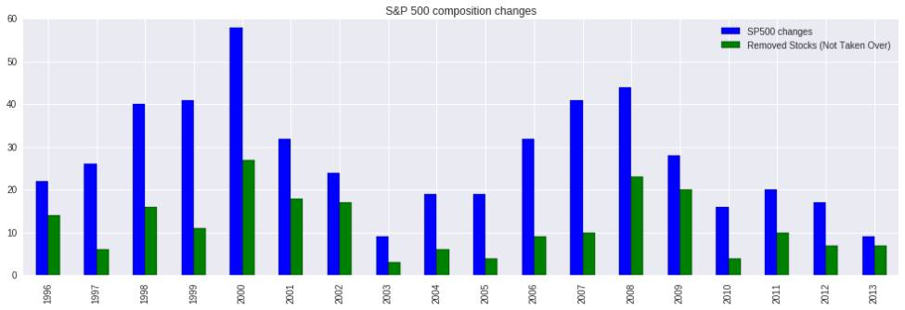
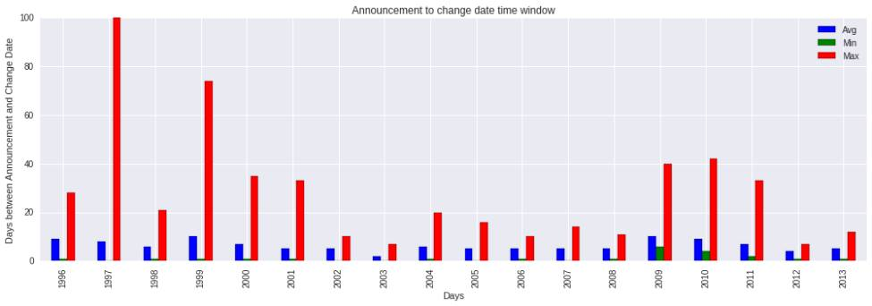
Events
Notes:
Chart 1
Number of events in our dataset
Cyclical behavior, peaks during dot com bubble and crisis.
24 changes on average per year
Chart 2
Average length of events is 5 days
Acquisition driven events can take 0 to 100 days

Slide 7
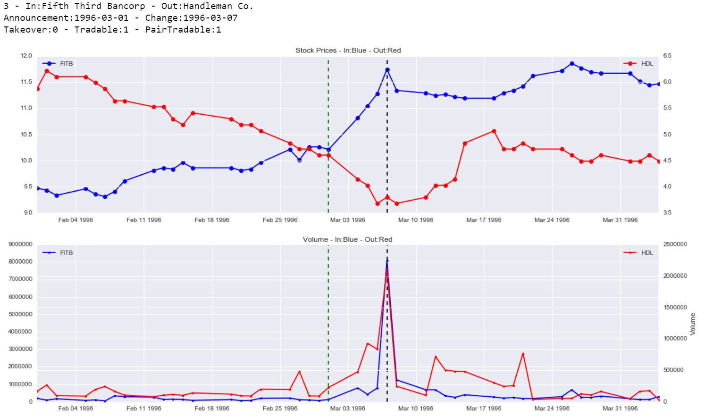
Ideal example
Notes:
Ideal example
Fifth Third Bancorp replaces Handleman Co. in 1996
Stock In: Drifts up from announcement to change
Stock Out: Drifts down from announcement to change
Increased volume in window + Huge spike in volume on change date

Slide 8
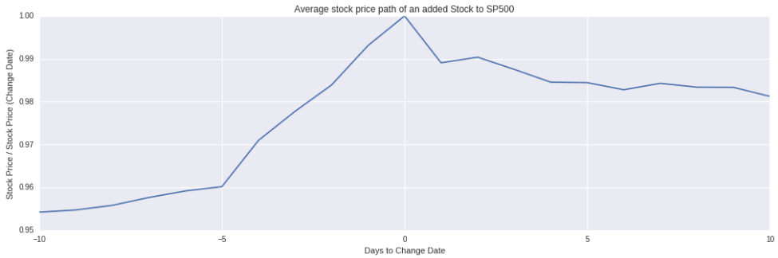
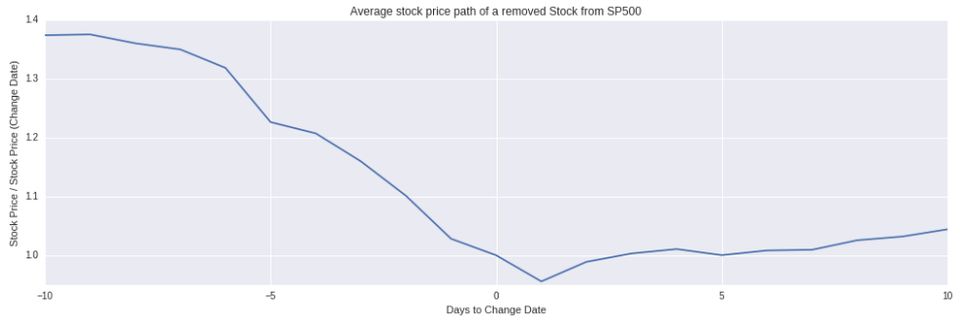
Price Effect
Notes:
Normalized average prices over whole dataset. Normalized to the price on the change date
In: Increase into change date, peak on change date -> slight rebound
Out: Decrease into change date, bottoms out one day after change date. Interesting.

Slide 9
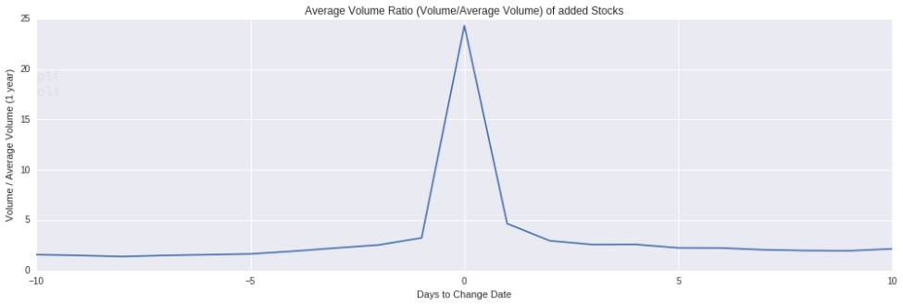
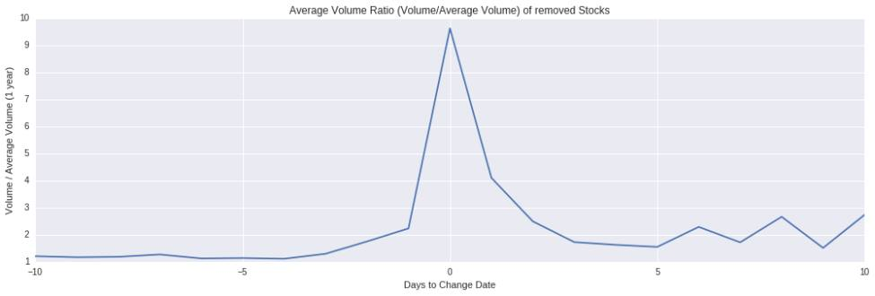
Volume effect
Notes:
Volume compared to the average volume over the past year
Increased volume on average + huge spike on change date

Slide 10
Constructing a trading strategy
Goal: Exploit observed patterns in stock prices
Loaded external data into XF db and created a customizable framework to test trading strategies
Dispersion trading strategies
Enter at open post announcement, close trade at closing on effective date
Fixed dollar amount on each trade ($10,000) and transaction costs
Distinct event dynamics limit trading options
Acquisition driven events (forced changes)
Usually only one of the stocks tradeable
Criteria driven events (unforced changes)
Both stocks tradeable
Notes:
Having analyzed the dataset we set out to construct a trading strategy.
Loaded all our external data in to the XF database and created a customizable framework to test trading strategies
Main setup
We set up simple long/short dispersion trading strategies. $10,000 exposure on each trade.
The position is opened as soon as we can after the announcement, at the opening the day after.
The position is closed at close on the effective change date
All trades are logged
Keep in mind that not all events are equivalent. Announcements are always in pairs.
We would ideally want to trade entering and exiting pairs on every event. Not possible since a majority of the events is acquisition driven.
The price of stocks deemed non-tradeable driven by other and stronger forces. Pegged to tender offer

Slide 11
Strategy 1
Trade all stocks joining the index against the index
Pro: Can trade all events
Con: Miss out on expected price drift of stocks leaving index
Setup:
Exposure: $10,000
Long: Stock joining index
Short: SPY ETF
Enter position: On open right after announcement date
Close position: On close on effective change date
Notes:
Started with trading on all events, had to limit ourselves to only trading stocks joining the index against the index itself.
Strategy: Long the stock entering the index and short the S&P500 index from announcement to change date.
Goal: Take advantage of abnormal excess returns (positive) of stocks entering the index.
Details: Open trade on the morning after the announcement is made. Short the index through the SPY ETF and use proceeds to go long the stock entering the index. Close trade at close of trading on the effective change date (sell the stock and buy back SPY shares)

Slide 12
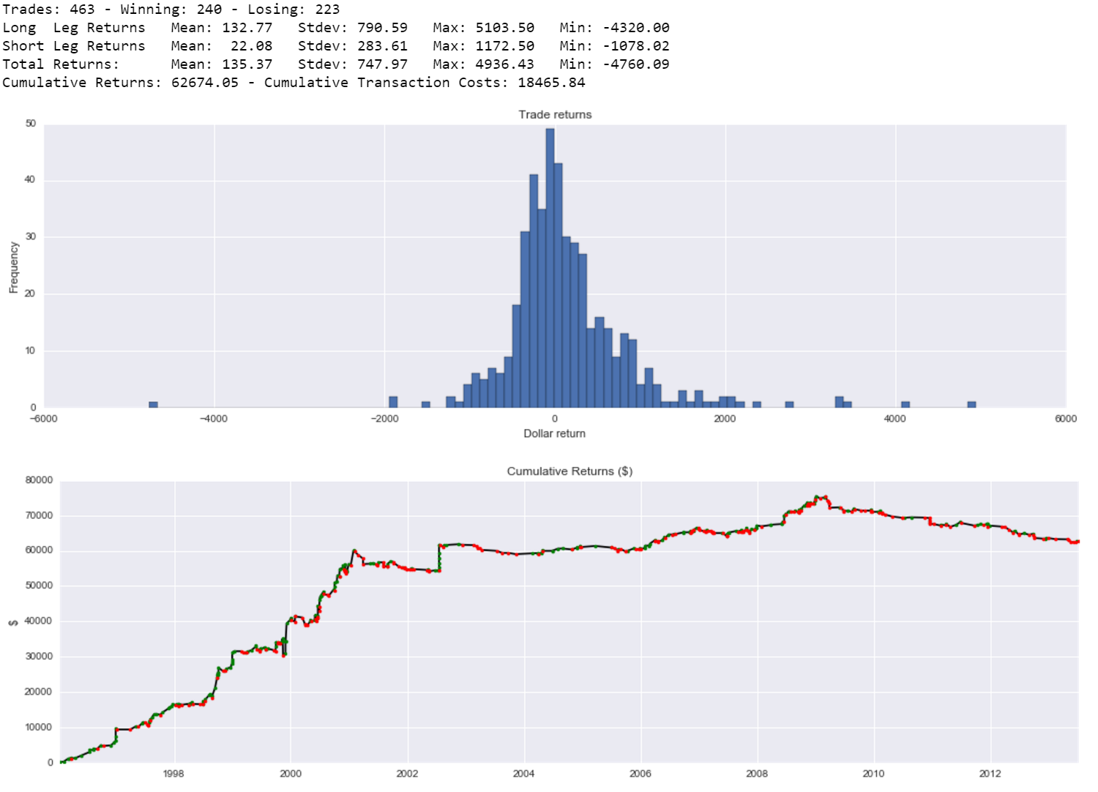
Strategy 1 - Results
Notes:
Stats and return distributions. Green dots winning trades and red dots losing
Results: Running this strategy from the beginning of 1996 to August 2013 we can see that on average the trades are profitable and the return distribution is positively skewed (large absolute returns are mostly positive). The standard deviation is relatively high compared to the average so the Sharpe ratio of this strategy is pretty low. The strategy was very profitable from 1996 until the early 2000's, after that the performance really slows down and then after the financial crisis the performance is actually negative.
Analysis: Hard to explain why exactly it not profitable any more. There has been a big increase in capital invested in passive funds in recent time which should amplify the phenomenon but the profitability has gone away. Fund managers are able to reduce their market impact and are smarter around these events.

Slide 13
Strategy 2
Pair trade stocks joining/leaving index on criteria driven events
Pro: Captures expected price drift of both joining and leaving stocks
Con: Can only trade on a subset of the events (< 40%)
Setup:
Exposure: $10,000
Long: Stock joining index
Short: Stock leaving index
Enter position: On open right after announcement date
Close position: On close on effective change date
Notes:
Strategy: Long the stock entering the index and short the stock leaving the index from announcement to change date.
Goal: Take advantage of abnormal excess returns of both stocks entering (positive) and leaving (negative) the index.
Details: Open trade on the morning after the announcement is made. Short the stock leaving the index and use proceeds to go long the stock entering the index. Close trade at close of trading on the effective change date (close long position then exit short).

Slide 14
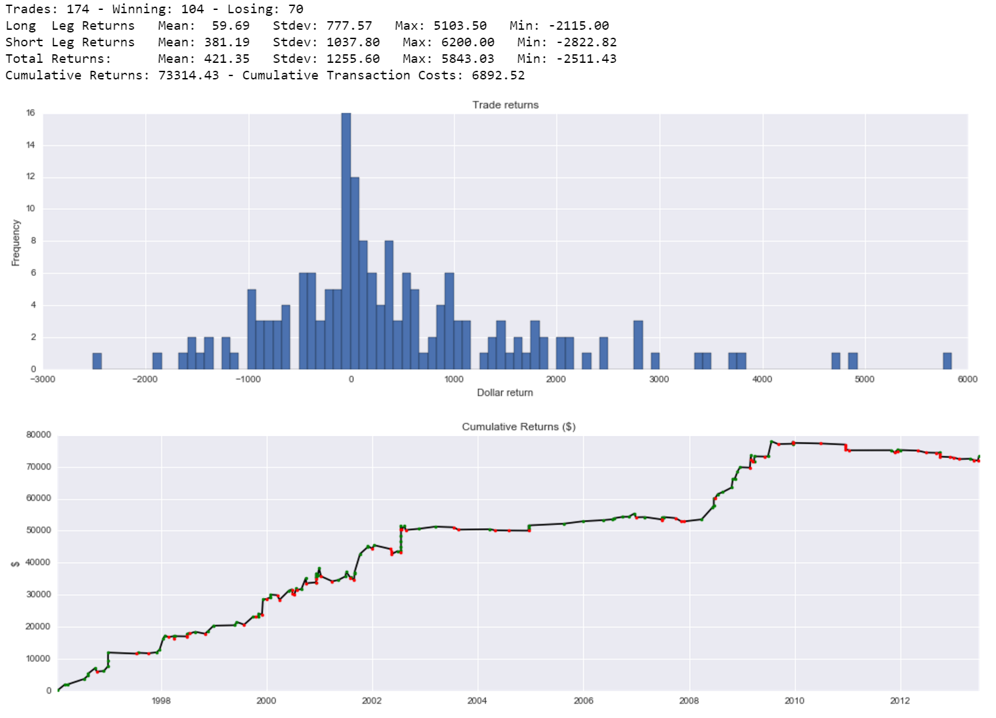
Strategy 2 - Results
Notes:
Results: This strategy is more profitable on average than the previous one and the return distribution is also very positively skewed. Both legs of the trade are profitable on average but trading the stocks leaving the index is much more profitable. Intuatively this makes sense since if a stock is being removed from the index it is more than likely that it has been underperforming in recent times and therefore that it's stock price has a negative momentum. The cumulative return profile is simlar to the profile of the previous strategy, very profitable until the early 2000's then it levels out until the crisis. During the crisis it was again pretty profitable and the momentum arguement applies again there. The stocks leaving the index during the crisis were most likely having big troubles due to the state of the markets and the economy. After the crisis the strategy has been pretty useless and has performed negatively if anything.

Slide 15
Final Strategy
Combine previous strategies
Trade all events and capture drifts of both stocks when available possible
Setup:
Exposure: $10,000
Long: Stock joining index
Short: Stock leaving index (criteria driven) or SPY ETF (acquisition driven)
Enter position: On open right after announcement date
Close position: On close on effective change date
Notes:
Strategy: Long the stock entering the index and short the stock leaving the index or the S&P500 index (depending on if the change is due to a take-over or not) from announcement to change date.
Goal: Take advantage of abnormal excess returns of stocks entering (positive) and leaving (negative) the index when possible, otherwise take advantage of stocks entering the index only.
Details: Open trade on the morning after the announcement is made. Short the stock leaving the index or the index itself through the SPY ETF and use proceeds to go long the stock entering the index. Close trade at close of trading on the effective change date.

Slide 16
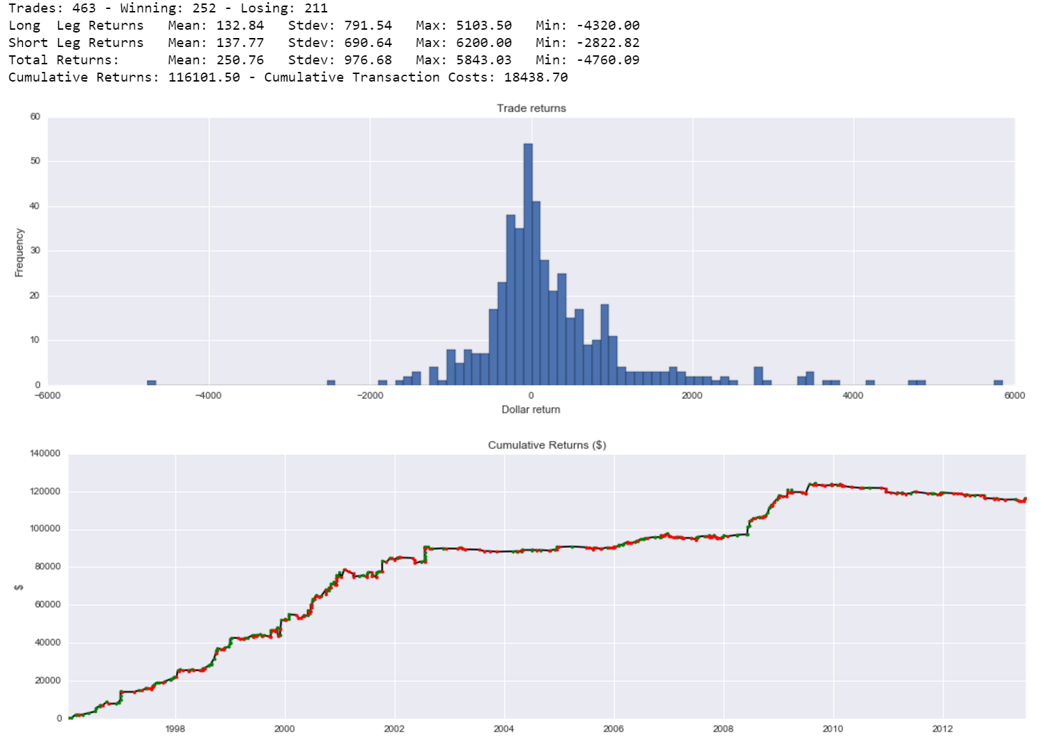
Final Strategy - Results
Notes:
Results: This strategy is the most profitable out of the three, as is expected it has a lower average return than the isolated pair trading scheme but it has three times as many trading opportunities so running this strategy from the beginning of 1996 to August 2013 results in the highest cumulative return. Cumulative return profile same as pair trading scheme and the return distribution is still positively skewed.

Slide 17
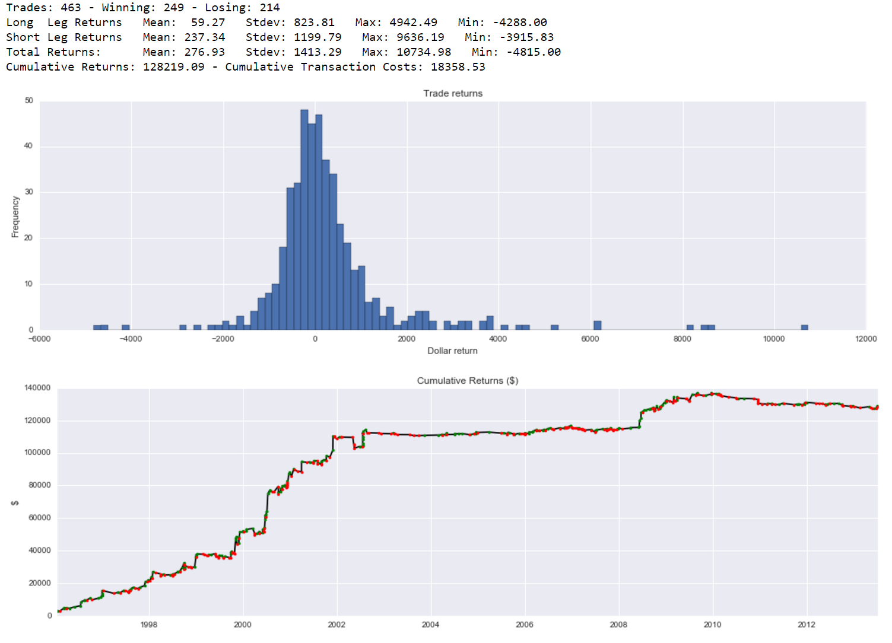
Timing the exit
Tested different exit strategies on the final trading scheme
Baseline (T=0) is close on effective change date
Tested exits on T-5 to T+5
Results
Exiting one day after change date (T+1) showed slightly better results than (T=0)
Fits with observed normalized price paths
Majority of gain captured before 2000 -> Not advisable for future trading

Slide 18
“Out of sample” Test
All rebalancing events from Sep 2013 to Apr 2016
Stock data from IVY through Wharton’s WRDS
Final strategy setup – Exit on effective change date
Not profitable
Notes:
Wanted to test the strategy on more recent data to see if anything has changed in recent times
Access to more recent data from IVY in Wharton’s WRDS database

Slide 19
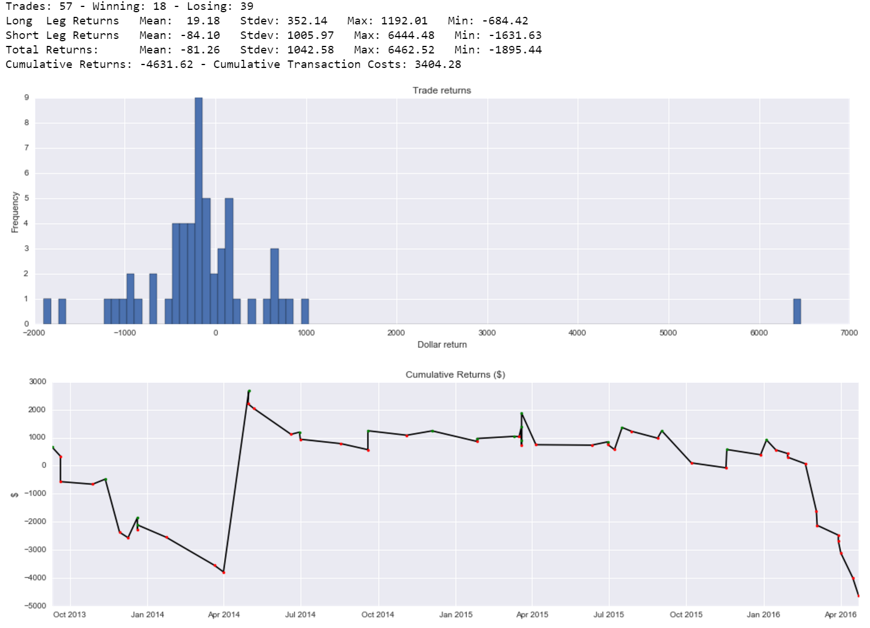
“Out of sample” - Results
Notes:
Awful results, majority of trades are losing
Would have had trouble with margin account.

Slide 20
What happened?
Massive inflows into passive index tracking funds in recent decade
Index Effect should be stronger
Is this a timing issue?
Tested final strategy where the trade is entered immediately after announcement, during after-hours trading on previous close price.
Idealized case and impossible to do consistently
Volume is limited during after-hours and prices are volatile
Competition with HFT
Results
Extremely profitable
Timing likely not the only issue though, Index Effect doesn’t grow as expected

Slide 21
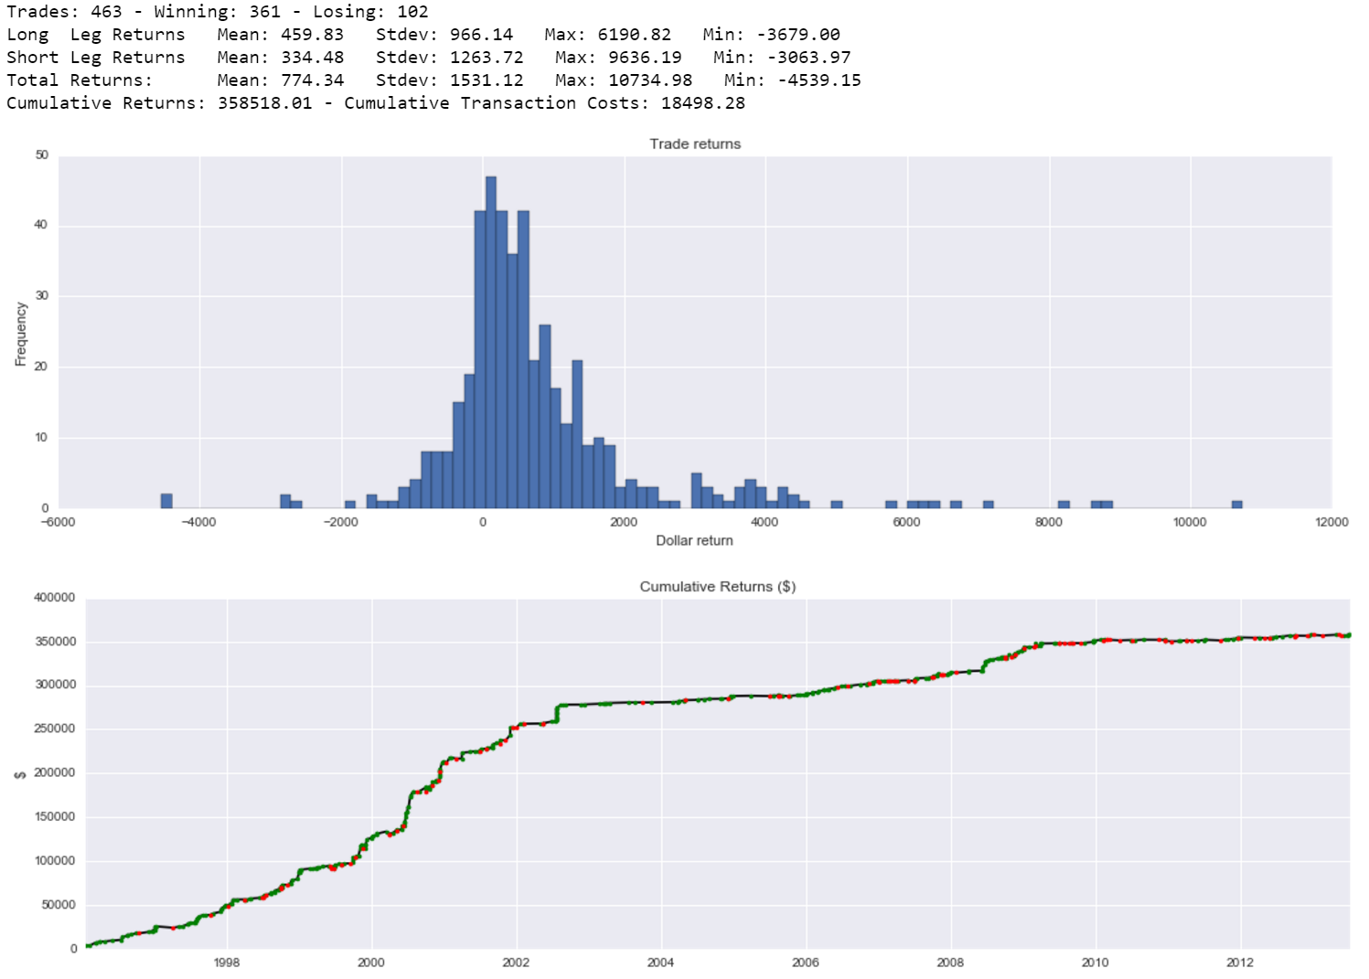
Optimal timing 1996-2013
Notes:
80% of trades profitable
Shows that a majority of the effect is realized during after-hours trading. We miss out on that by trading at the opening the day after
Extremely profitable from 1996 to 2002, able to capture a majority of the drift effect.
Slows down after that but still respectable, reiterate that this is impossible
The previous settings are not realistic, being able to trade at open, but this is completely out of the question
Even with perfect timing there is a clear regime change

Slide 22
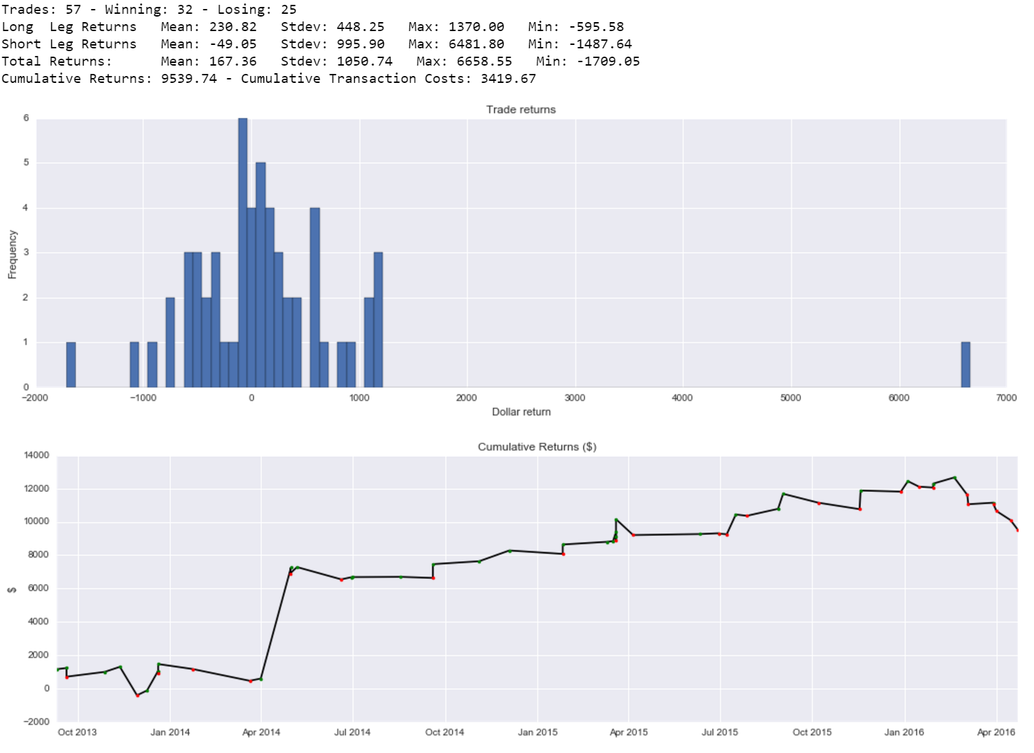
Optimal timing 2013-2016
Notes:
Looks better but results skewed by one large trade
Takeaway from this: Even with perfect timing this strategy is not worthwhile to pursue in today’s market

Slide 23
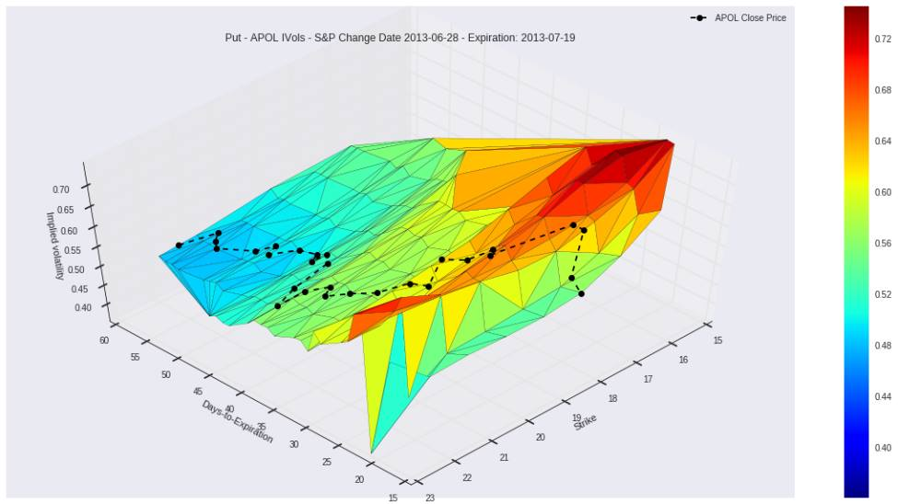
Extra - Options Studies
Does S&P 500 rebalancing have a systematic impact on options markets?
We looked at dynamics around the events
Implied volatility levels
Volume and Open Interest
Skews
No exploitable patterns

Slide 24
Conclusion
Simple dispersion strategies very profitable from 1996 until early 2000’s
Not worthwhile to pursue in todays market even though underlying effect should be stronger
Why is this not profitable anymore?
Awareness
Research in 2000’s
Anticipation
Index criteria public information
Markets
Smart execution algorithms
After-hours trading
Extensions
Anticipate index changes
Test other indexes
Notes:
Earliest research dates back to 80’s but there was some interest in the topic in the early 2000’s. Data driven research as data vendors enter the market.
Smart fund managers might try to anticipate changes beforehand. The criteria that the S&P index committee is somewhat transparent but there is always some uncertainty.
Fund managers employing smarter execution methods, reducing market impact.
After hours trading. All of the announcements are made after the close of the market. Studies suggest that a majority of the effect is captured during after-hours trading.
Extensions
With the previous example in mind one could hope to take advantage of this phenomenon by anticipating index changes. You could monitor the criteria that the S&P500 index committee uses to evaluate eligble companies (which public information) for a selection of stocks and react to cases where the probability that a stock will be selected for additition or deletion from the index is high. Example: If a stock is likely to be removed from the index then identify the stock that is most likely to replace it and go long that stock and short the stock in the index. With some pre-determined hyperparameters (stop-loss, maximum duration of trade, etc.)
The S&P500 index is the index that is mostly widely tracked by passive funds and investors. Even though the profitability of the dispersion strategy is pretty low in recent times there could exist opportunities for indexes. For example the Russell indexes or sector based indexes;.

Slide 25
Event: Earnings Surprises
According to M. Cremers, A. Fodor, D. Weinbaum: “option traders’ information processing ability stems primarily from their ability to identify underreaction to news; their trades are informative about future prices when they buy call options on stocks that have experienced positive news events and when they buy put options on stocks that have experienced negative news events”
Assumption: Options markets participants are better informed as to how news events affect future prices than equity market participants.

Slide 26
Dataset
Earnings data (date, surprises) for 50 large-cap and 50 mid-cap companies from http://www.streetinsider.com/
Original authors use buy-to-open and sell-to-open data; we don’t have access to this
Instead, track open interest as a proxy

Slide 27
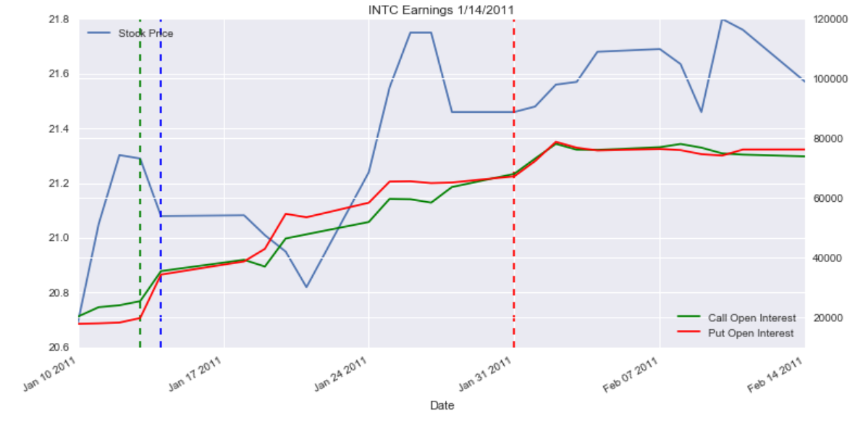
Example

Slide 28
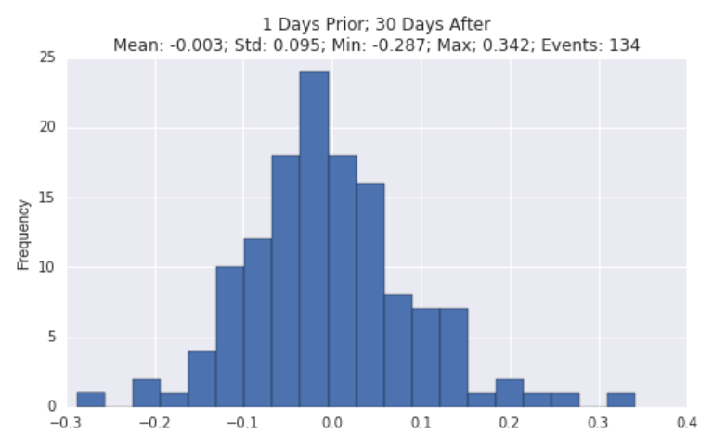
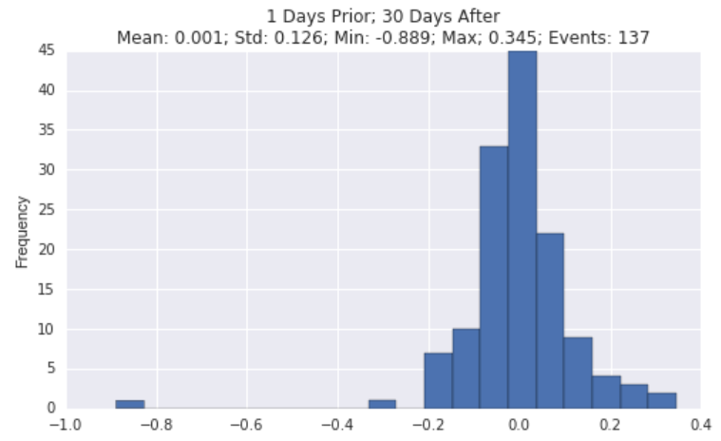
Results: Diverging Open Interest
At the Money
Out of the Money

Slide 29
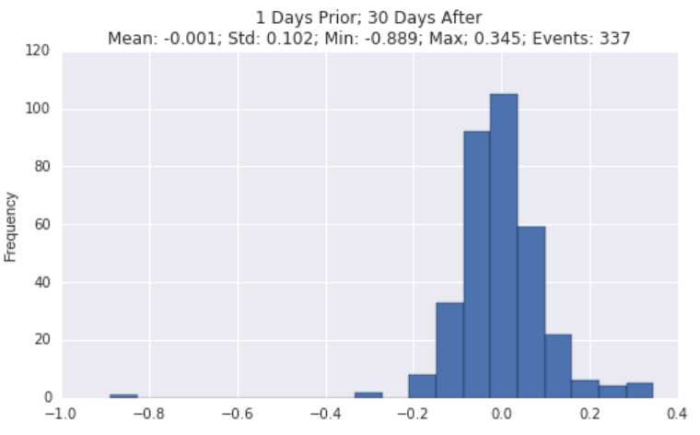
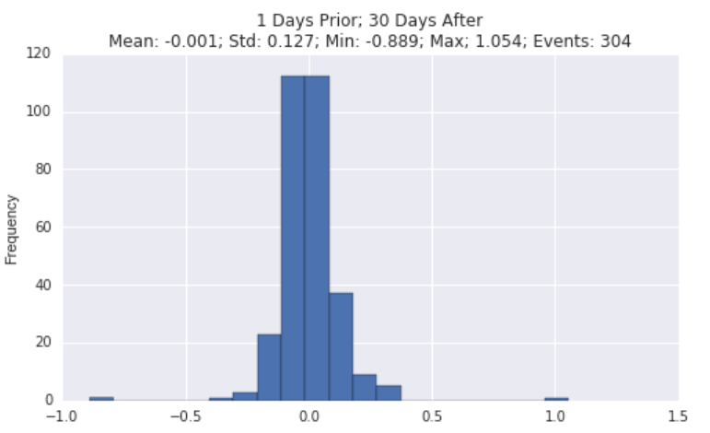
Results: Relative Open Interest
At the Money
Out of the Money

Slide 30
Conclusion
Open interest is not informative
Strategy is likely to be very unprofitable
Extensions:
Different market caps/sectors
Different proxies for buying/selling pressure

